Slide 1
Getting gRPC
Jason Bock

Slide 2
Personal Info
http://www.jasonbock.net
https://www.twitter.com/jasonbock
https://www.github.com/jasonbock
jason.r.bock@outlook.com

Slide 3
Downloads
https://github.com/JasonBock/WhatsNewInNETCore3

Slide 4
Overview
Overview
Demos
WCF
Remember...
https://github.com/JasonBock/WhatsNewInNETCore3

Slide 5

Overview
http://www.security-faqs.com/wp-content/uploads/2010/02/why-buy-antivirus.jpg
Notes:
So, why gRPC? What is so interesting about it?

Slide 6
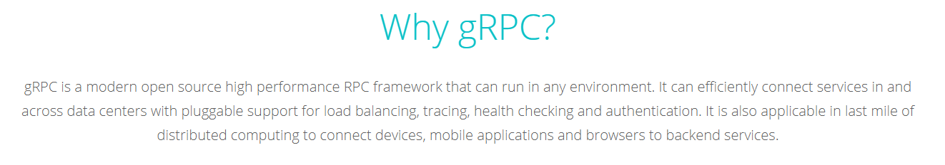
Overview
https://grpc.io/
Notes:
Here’s the elevator pitch

Slide 7
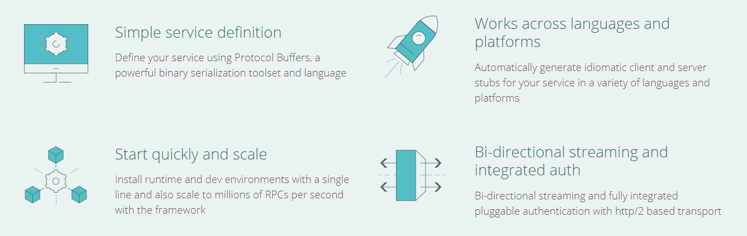
Overview
https://grpc.io/
Notes:
The main 4 points. Also, from the FAQ:
Low latency, highly scalable, distributed systems.
Developing mobile clients which are communicating to a cloud server.
Designing a new protocol that needs to be accurate, efficient and language independent.
Layered design to enable extension eg. authentication, load balancing, logging and monitoring etc.

Slide 8
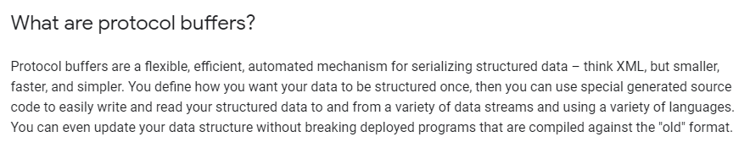
Overview
https://developers.google.com/protocol-buffers/docs/overview
Notes:
Protocol buffers, or protobuf, are what you use to defines messages in contracts.

Slide 9
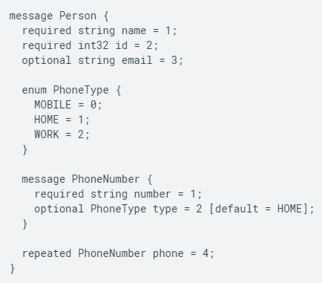
Overview
https://developers.google.com/protocol-buffers/docs/overview
Notes:
Protocol buffers, or protobuf, are what you use to defines messages in contracts.

Slide 10
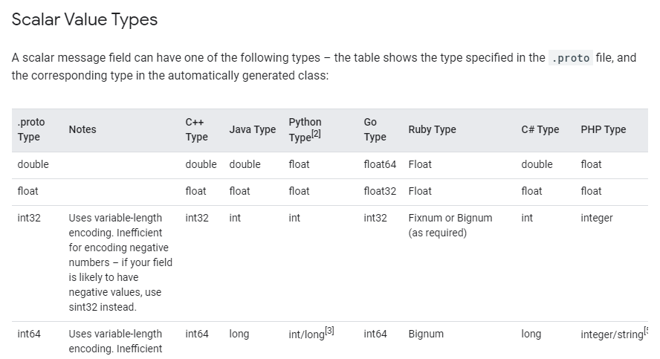
Overview
https://developers.google.com/protocol-buffers/docs/proto3
Notes:
There’s a whole bunch of documentation on the proto3, which is the current versioned specification.

Slide 11

Overview
https://grpc.io/faq/
Notes:
Love the acronym definition.

Slide 12


Overview
+
So let’s see how you can use gRPC in .NET
Notes:
Love the acronym definition.

Slide 13
Demo: Using gRPC in .NET
Getting gRPC

Slide 14
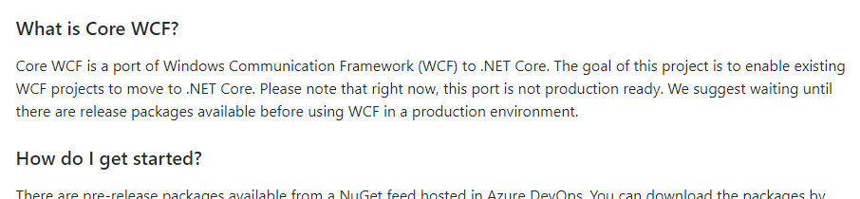
WCF
https://github.com/CoreWCF/CoreWCF
Notes:
If you’re currently doing WCF, you must decide on what to do in the future. Either move to gRPC (or REST/HTTPS), stay on WCF + .NET Framework, or consider other options, like CoreWCF

Slide 15
Getting gRPC
Jason Bock
Notes:
gRPC for .NET Examples - https://github.com/grpc/grpc-dotnet/tree/master/examples
A new experiment: Call .NET gRPC services from the browser with gRPC-Web - https://devblogs.microsoft.com/aspnet/grpc-web-experiment/
Implementing State in .NET Core gRPC Messages with oneof - https://visualstudiomagazine.com/articles/2020/01/13/state-in-grpc.aspx
Building Microservices with gRPC and .NET - https://channel9.msdn.com/Shows/The-Cloud-Native-Show/Building-Microservices-with-gRPC-and-NET
.NET Core: Writing Really Obvious Code with Enumerated Values in gRPC Web Services - https://visualstudiomagazine.com/articles/2020/01/08/grpc-enumerated-values.aspx
Versioning gRPC services - https://docs.microsoft.com/en-us/aspnet/core/grpc/versioning
How to Design Messages for gRPC Services in .NET Core - https://visualstudiomagazine.com/articles/2020/01/06/defining-grpc-messages.aspx
gRPC as a Replacement for WCF - https://www.codemag.com/article/1911102
Writing the Code for a gRPC Service and Client in ASP.NET Core 3.0 - https://visualstudiomagazine.com/articles/2019/10/03/writing-grpc-service.aspx
.NET Core ❤ gRPC - https://grpc.io/blog/grpc-on-dotnetcore/
gRPC for WCF Developers - https://github.com/dotnet/docs/tree/master/docs/architecture/grpc-for-wcf-developers
gRPC and C# 8 Async stream - https://laurentkempe.com/2019/09/18/gRPC-and-csharp-8-Async-stream/
Authentication and authorization in gRPC for ASP.NET Core - https://docs.microsoft.com/en-us/aspnet/core/grpc/authn-and-authz?view=aspnetcore-3.0
Talking between services with gRPC, and other tricks - Marc Gravell - https://www.youtube.com/watch?v=W-bULzA0ki8
C# Quick Start - https://grpc.io/docs/quickstart/csharp/
gRPC Basics - C# - https://grpc.io/docs/tutorials/basic/csharp/
Tutorial: Create a gRPC client and server in ASP.NET Core - https://docs.microsoft.com/en-us/aspnet/core/tutorials/grpc/grpc-start
gRPC services with C# - https://docs.microsoft.com/en-us/aspnet/core/grpc/basics?view=aspnetcore-3.0
UnWCF: Moving on from Windows Communication Foundation - https://unwcf.com/

